Slide 1

The Horticultural Association
K7 Project Team

Slide 2
Project overview
HAA approached PSI for a web-based software solution
This system will include:
Database Management System
Report generation
Integration with GARD and website

Slide 3
Quality Assurance and Project Approach
SCRUM
IEEE STD 730-2014
The final product will ensure to have these characteristics
Fit-for-purpose: It is designed for intended use
Compliance: Software complies with the law
Conformance: Conforms to the requirements stated in the contract
Right-the-first-time: Errors will be picked up straight away to reduce cost and time

Slide 4
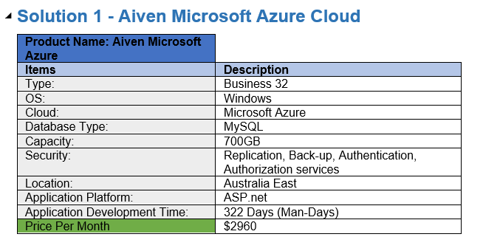
Solution 1

Slide 5
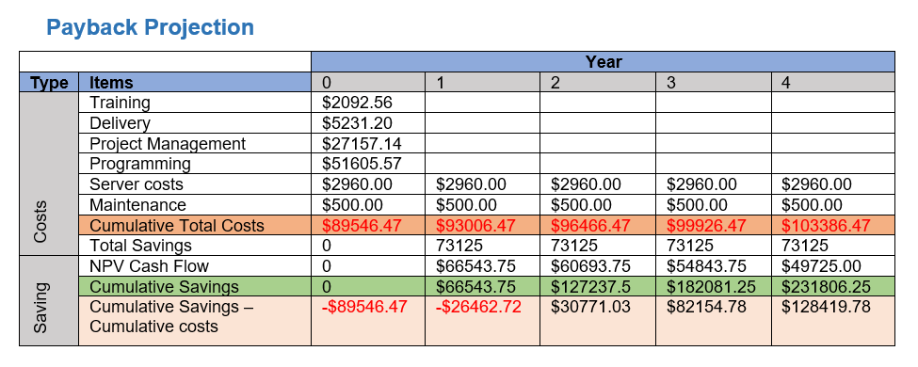
Solution 1 Pay Back Projection

Slide 6
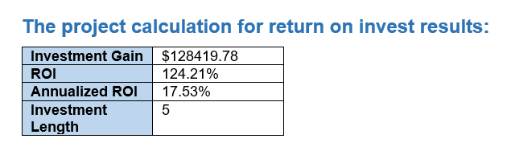
Solution 1
Benefits
Highly secure system to implement controls on data
Improvements in transactional speed and efficiency
Improved system to handle information from clients in a legal way
Highly Integrated system that will be migrated easily
Capacity improvements with the ability to improve in the future
Business can concentrate on core aspects of the business
Improved communication system with added report generation features
Work can be completed off-site
Cost

Slide 7
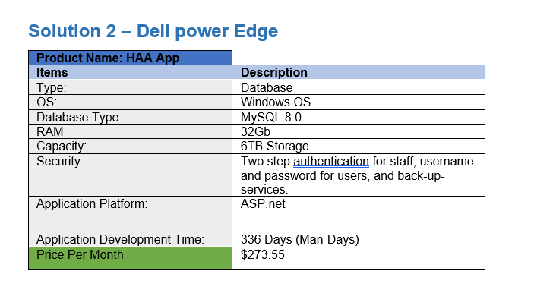
Solution 2

Slide 8
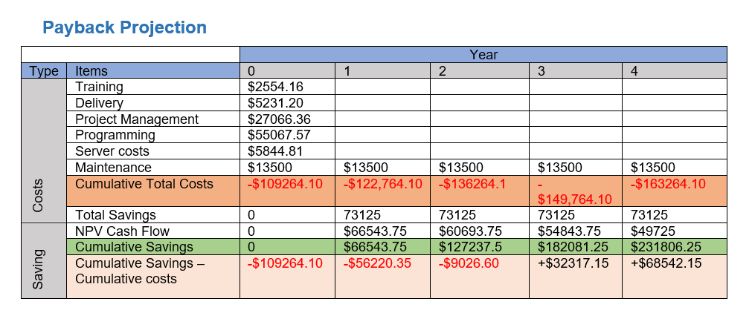
Solution 2 Pay Back Projection

Slide 9
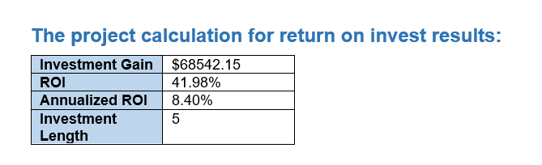
Solution 2
Benefits
Extra security placed on onsite databases and servers
Redundant devices in case of breaking
Redundant database
Easy replacement of devices and / or servers
Backup servers can be maintained
Redundant internet connections
Widely available web-application for various devices
Access from many locations
Information on traffic and statistics and usage by users
Security systems on the router and application
Utilization of download statistics and app feedback sections in app stores.
Extra security can be placed on devices for authentication and two step authentication.
Cost

Slide 10
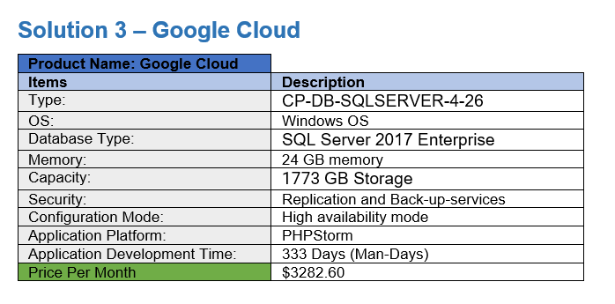
Solution 3

Slide 11
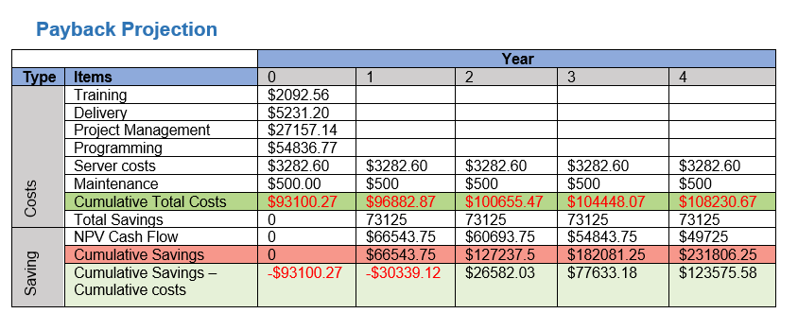
Solution 3 Pay-Back Projection

Slide 12
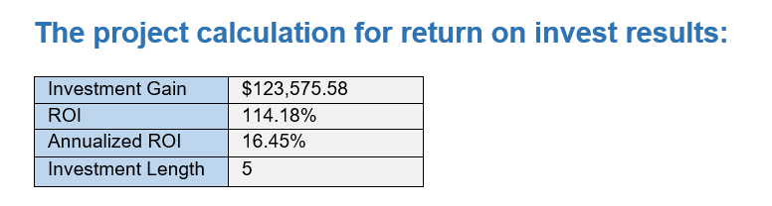
Solution 3
Benefits
Highly secure system to implement controls on data
Improvements in transactional speed and efficiency
Improved system to handle information from clients in a legal way
Highly Integrated system that will be migrated easily
Capacity improvements with the ability to improve in the future
Business can concentrate on core aspects of the business
Improved communication system with added report generation features
Work can be completed off-site
Cost

Slide 13
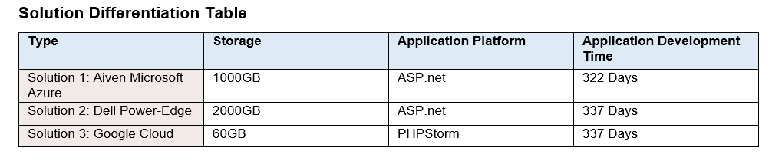
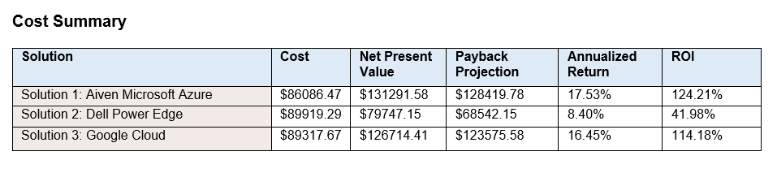
Recommended solution
We recommend Solution 1 as it provides:
Superior storage and capacity of the database
Less application development time
Greater long term financial benefit
Native ASP.net platform significantly reduces the amount of time and effort.
Provides two factor authentication and other functions

Slide 14
Thank you for your time.
We look forward to further liaisons with you.

